Slide 1


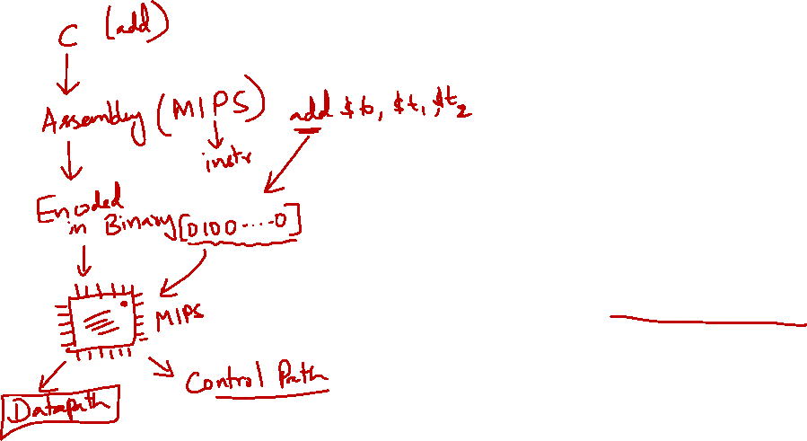
http://www.comp.nus.edu.sg/~cs2100/
Lecture #11
The Processor: Datapath
Note
You will only learn the components in the next half of the semester. For now, it is easier to just think about them as a function BUT created as a hardware. So the explanation is a functional explanation.

Slide 2
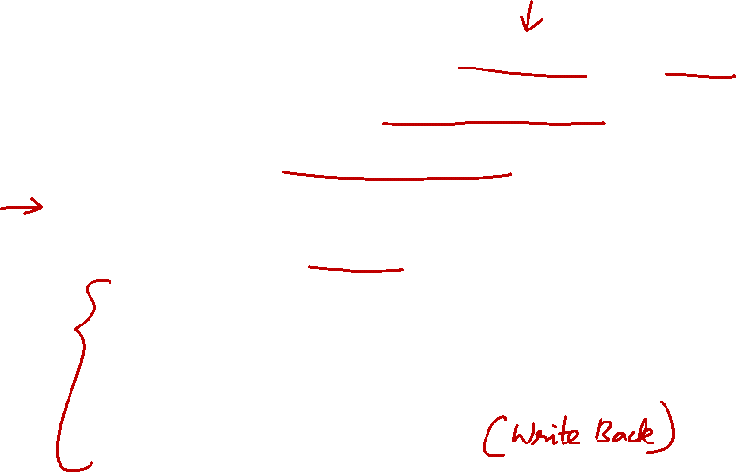
Lecture #11: Processor: Datapath (1/2)
Building a Processor: Datapath & Control
MIPS Processor: Implementation
Instruction Execution Cycle (Recap)
MIPS Instruction Execution
Let’s Build a MIPS Processor
5.1 Fetch Stage
5.2 Decode Stage
5.3 ALU Stage
5.4 Memory Stage
5.5 Register Write Stage

Slide 3
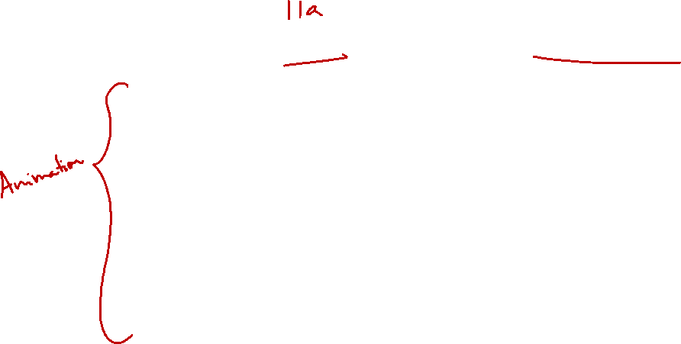
Lecture #11: Processor: Datapath (2/2)
The Complete Datapath!
Brief Recap
From C to Execution
8.1 Writing C program
8.2 Compiling to MIPS
8.3 Assembling to Binaries
8.4 Execution (Datapath)

Slide 4
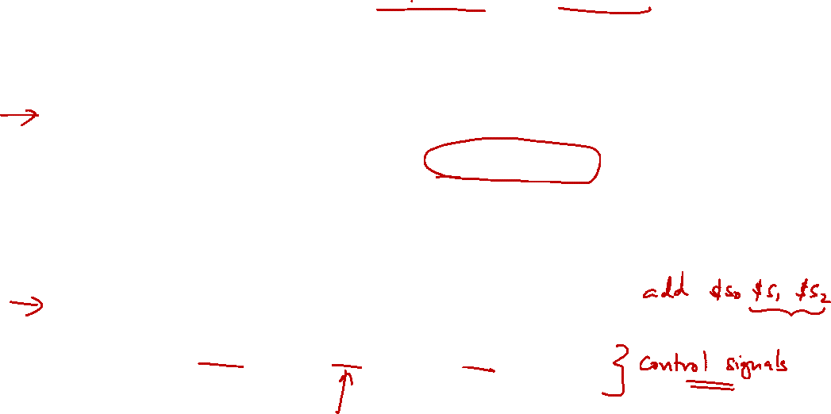
1. Building a Processor: Datapath & Control
Two major components for a processor
Datapath
Collection of components that process data
Control
Tells the datapath, memory and I/O devices what to do according to program instructions
Performs the arithmetic, logical and memory operations

Slide 5

2. MIPS Processor: Implementation
Simplest possible implementation of a subset of the core MIPS ISA:
Arithmetic and Logical operations
add, sub, and, or, addi, andi, ori, slt
Data transfer instructions
lw, sw
Branches
beq, bne
Shift instructions (sll, srl) and J-type instructions (j) will not be discussed:
Left as exercises ☺
Note
andi and ori is not supported in this current processor design because we always do "sign extension" on immediate value
Note
sll and srl can be done by multiplication (which can be done by add with loop). j can be done by beq $zero, $zero, label if we ignore the difference related to 256MB blocks.

Slide 6
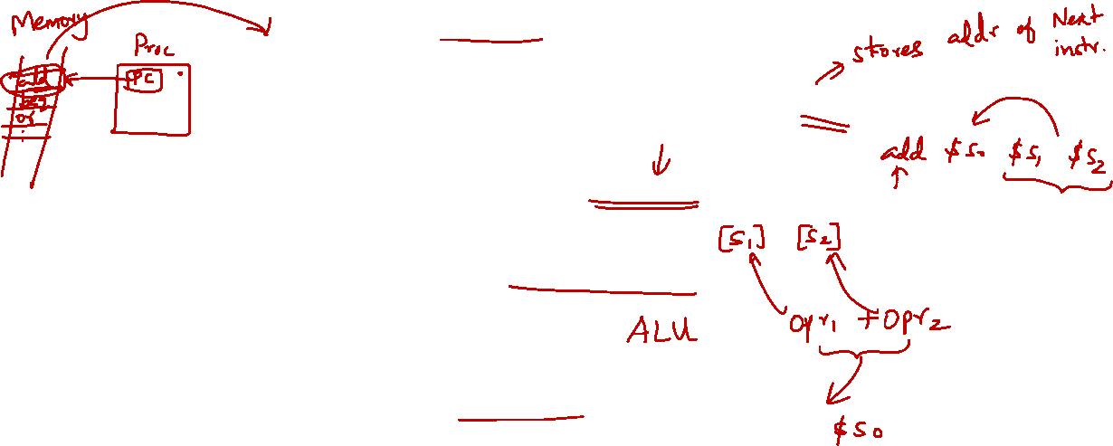
3. Instruction Execution Cycle (Basic)
Fetch:
Get instruction from memory
Address is in Program Counter (PC) Register
Decode:
Find out the operation required
Operand Fetch:
Get operand(s) needed for operation
Execute:
Perform the required operation
Result Write (Store):
Store the result of the operation
Instruction
Fetch
Instruction
Decode
Next Instruction
Operand
Fetch
Execute
Result
Write

Slide 7
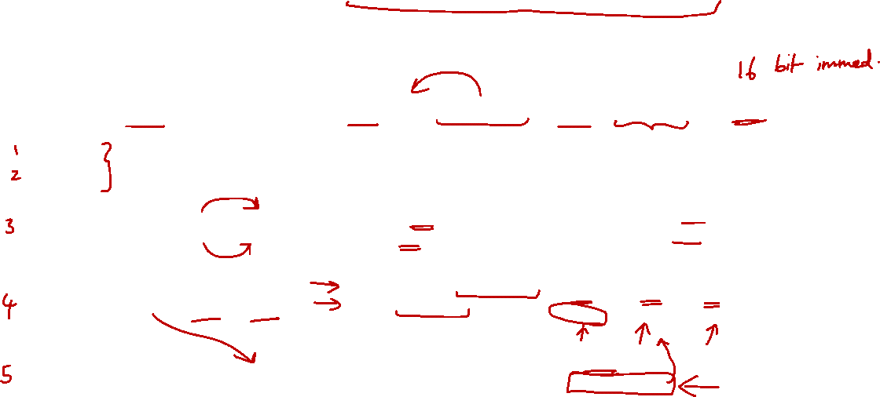
4. MIPS Instruction Execution (1/2)
Show the actual steps for 3 representative MIPS instructions
Fetch and Decode stages not shown:
The standard steps are performed
 | add $rd, $rs, $rt | lw $rt, ofst($rs) | beq $rs, $rt, ofst
Fetch | standard | standard | standard
Decode
Operand Fetch | Read [$rs] as opr1 Read [$rt] as opr2 | Read [$rs] as opr1 Use ofst as opr2 | Read [$rs] as opr1 Read [$rt] as opr2
Execute | Result = opr1 + opr2 | MemAddr = opr1 + opr2 Use MemAddr to read from memory | Taken = (opr1 == opr2 )? Target = (PC+4) + ofst×4
Result Write | Result stored in $rd | Memory data stored in $rt | if (Taken) PC = Target
add $rd, $rs, $rt | lw $rt, ofst($rs) | beq $rs, $rt, labl
opr = operand
MemAddr = address
ofst = offset

Slide 8
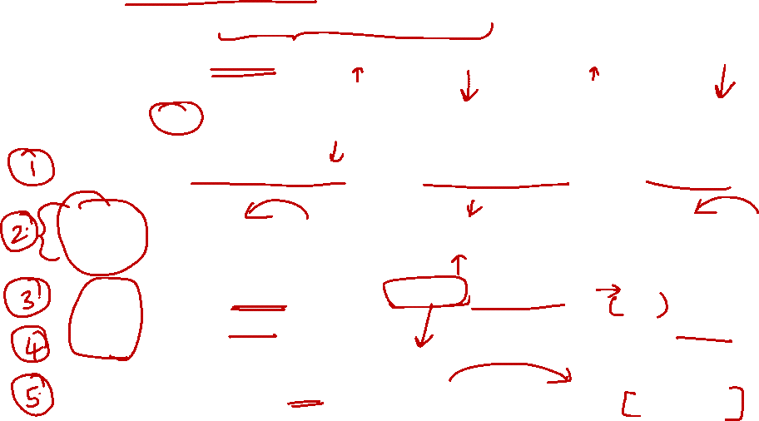
4. MIPS Instruction Execution (2/2)
Design changes:
Merge Decode and Operand Fetch – Decode is simple for MIPS
Split Execute into ALU (Calculation) and Memory Access
 | add $rd, $rs, $rt | lw $rt, ofst($rs) | beq $rs, $rt, ofst
Fetch | Read instr from [PC] | Read instr from [PC] | Read instr from [PC]
Decode | Read [$rs] as opr1 Read [$rt] as opr2 | Read [$rs] as opr1 Use ofst as opr2 | Read [$rs] as opr1 Read [$rt] as opr2
Operand Fetch
ALU | Result = opr1 + opr2 | MemAddr = opr1 + opr2 | Taken = (opr1 == opr2 )? Target = (PC+4) + ofst×4
Memory Access |  | Use MemAddr to read from memory
Result Write | Result stored in $rd | Memory data stored in $rt | if (Taken) PC = Target

Slide 9
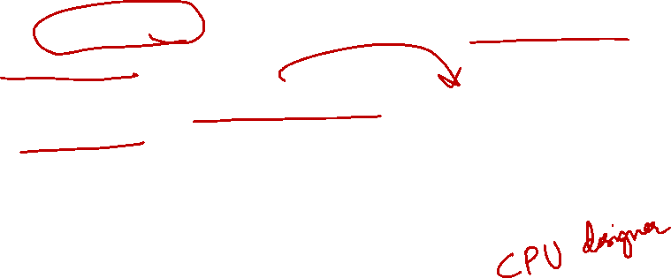
5. Let’s Build a MIPS Processor
What we are going to do:
Look at each stage closely, figure out the requirements and processes
Sketch a high-level block diagram, then zoom in for each elements
With the simple starting design, check whether different type of instructions can be handled:
Add modifications when needed
➔ Study the design from the viewpoint of a designer, instead of a "tourist" ☺

Slide 10
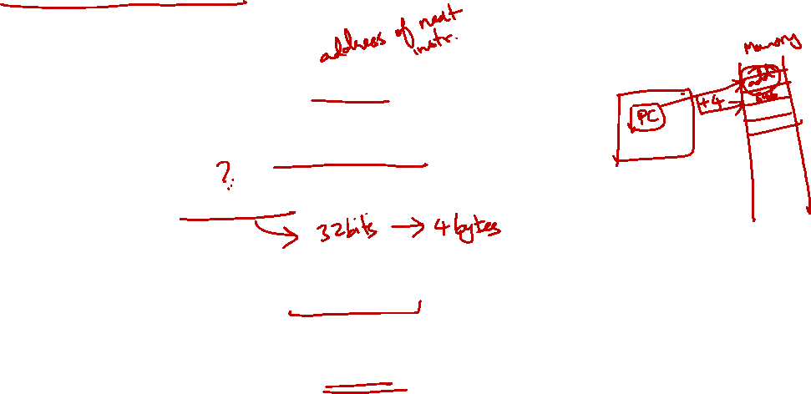
Fetch
Decode
ALU
Memory
RegWrite
5.1 Fetch Stage: Requirements
Instruction Fetch Stage:
Use the Program Counter (PC) to fetch the instruction from memory
PC is implemented as a special register in the processor
Increment the PC by 4 to get the address of the next instruction:
How do we know the next instruction is at PC+4?
Note the exception when branch/jump instruction is executed
Output to the next stage (Decode):
The instruction to be executed

Slide 11
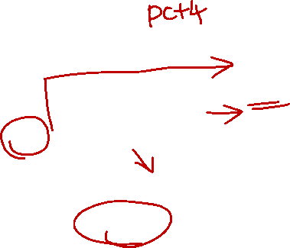
5.1 Fetch Stage: Block Diagram
A simple adder
Add
4
Decode Stage
PC
Instruction
Address
Instruction
Instruction
A register
Instruction
Memory
Memory which stores program instructions

Slide 12
5.1 Fetch Stage: Block Diagram
Use the Program Counter (PC) to fetch the instruction from memory
A simple adder
Add
4
Decode Stage
PC
Instruction
Address
Instruction
Instruction
A register
Instruction
Memory
Memory which stores program instructions

Slide 13
5.1 Fetch Stage: Block Diagram
A simple adder
Add
4
Decode Stage
PC
Instruction
Address
Instruction
Instruction
A register
Instruction
Memory
Memory which stores program instructions
Increment the PC by 4 to get the address of the next instruction:

Slide 14

5.1 Fetch Stage: Block Diagram
A simple adder
Output to the next stage (Decode):
Add
4
Decode Stage
PC
Instruction
Address
Instruction
Instruction
A register
Instruction
Memory
Memory which stores program instructions

Slide 15
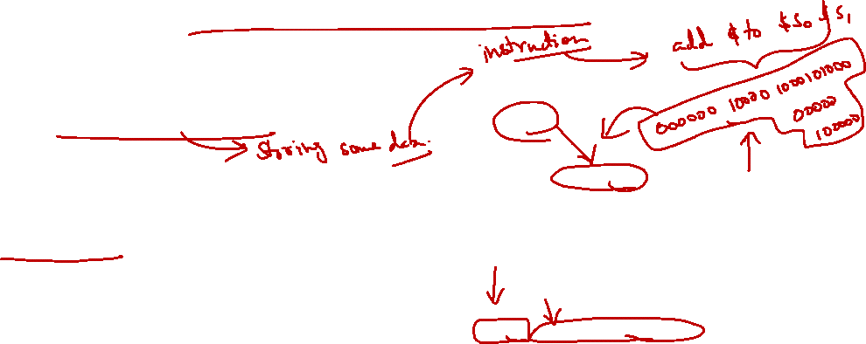
5.1 Element: Instruction Memory
Storage element for the instructions
It is a sequential circuit (to be covered later)
Has an internal state that stores information
Clock signal is assumed and not shown
Supply instruction given the address
Given instruction address M as input, the memory outputs the content at address M
Conceptual diagram of the memory layout is given on the right ➔
Instruction
Address
Instruction
Instruction
Memory
Memory
………..
2048
add $3, $1, $2
2052
sll $4, $3, 2
2056
andi $1, $4, 0xF
……
………..
As a Function
function IM(addr) {
return Mem[addr];
}

Slide 16
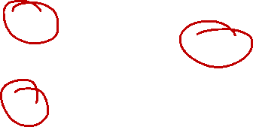
5.1 Element: Adder
Combinational logic to implement the addition of two numbers
Inputs:
Two 32-bit numbers A, B
Output:
Sum of the input numbers, A + B
32
A
A+B
Add
Sum
32
32
B
As a Function
function add(A,B) {
return A+B;
}

Slide 17
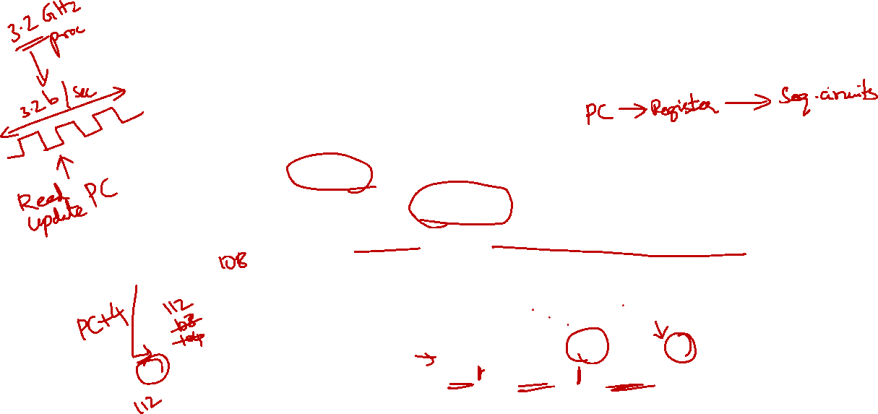
5.1 The Idea of Clocking
It seems that we are reading and updating the PC at the same time:
How can it works properly?
Magic of clock:
PC is read during the first half of the clock period and it is updated with PC+4 at the next rising clock edge
Note
Between these two, the value of PC is stable and can be read
Note
Writing is done at this "instant" of time (rising clock edge). The new value must be ready before this point.
Add
Time
4
Clk
PC
Read
address
In
100
104
108
112
PC
Instruction
Instruction
memory
In
104
108
112
116

Slide 18
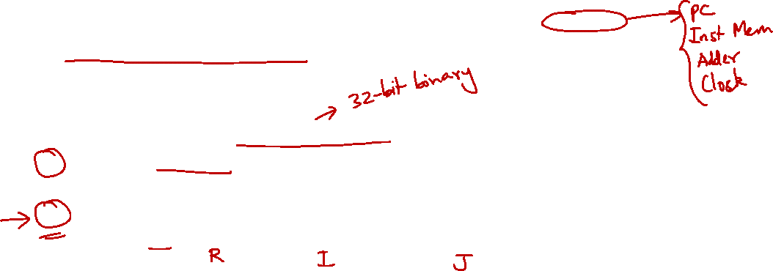
Fetch
Decode
ALU
Memory
RegWrite
5.2 Decode Stage: Requirements
Instruction Decode Stage:
Gather data from the instruction fields:
Read the opcode to determine instruction type and field lengths
Read data from all necessary registers
Can be two (e.g. add), one (e.g. addi) or zero (e.g. j)
Input from previous stage (Fetch):
Instruction to be executed
Output to the next stage (ALU):
Operation and the necessary operands

Slide 19
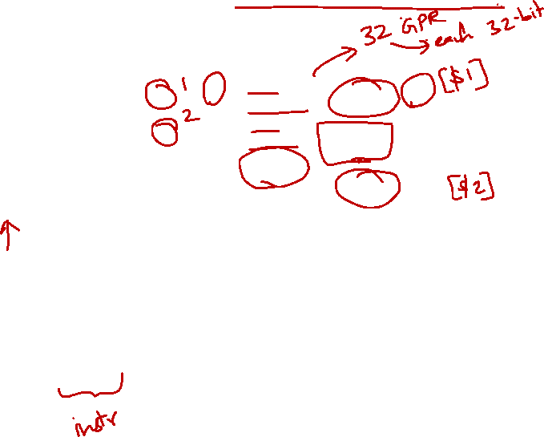
5.2 Decode Stage: Block Diagram
Register
numbers
ALU Stage
5
Read
register 1
Read
data 1
32
Fetch Stage
5
Read
register 2
Register
File
Data
5
Write
register
Read
data 2
32
opcode
31:26
rs
25:21
Inst
000000
rt
20:16
rd
15:11
shamt
10:6
funct
5:0
00000
00000
00000
00000
000000
Collection of registers, known as register file
Assembled instruction

Slide 20
5.2 Decode Stage: Block Diagram
Register
numbers
opcode
31:26
000000
ALU Stage
5
Read
register 1
Read
data 1
32
rs
25:21
00000
5
Read
register 2
Fetch Stage
Register
File
Data
rt
20:16
5
Write
register
00000
Read
data 2
32
Inst
rd
15:11
00000
shamt
10:6
00000
Collection of registers, known as register file
Assembled instruction
funct
5:0
000000
Input from previous stage (Fetch):
Instruction to be executed

Slide 21
5.2 Decode Stage: Block Diagram
Register
numbers
opcode
31:26
000000
ALU Stage
5
Read
register 1
Read
data 1
32
rs
25:21
00000
5
Read
register 2
Fetch Stage
Register
File
Data
rt
20:16
5
Write
register
00000
Read
data 2
32
Inst
rd
15:11
00000
shamt
10:6
00000
Collection of registers, known as register file
Assembled instruction
funct
5:0
000000
Output to the next stage (ALU):
Operation and the necessary operands

Slide 22
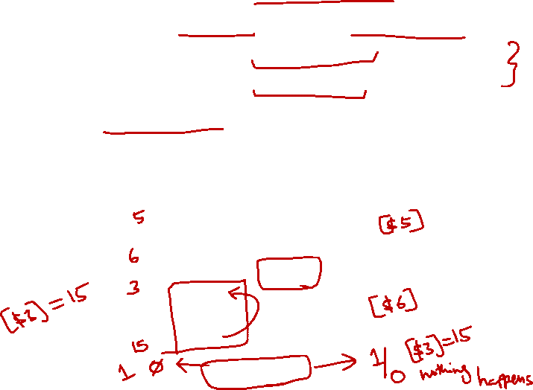
5.2 Element: Register File
A collection of 32 registers:
Each 32-bit wide; can be read/written by specifying register number
Read at most two registers per instruction
Write at most one register per instruction
RegWrite is a control signal to indicate:
Writing of register
1(True) = Write, 0 (False) = No Write
5
Read
register 1
As a Function
// Decode Stage
function RegRead(RR1, RR2) {
return [Reg[RR1], Reg[RR2]];
}
// Writeback Stage
function RegWrite(WR, WD, RegWrite) {
if(RegWrite) {
Reg[WR] = WD;
}
}
Read
data 1
32
Register
numbers
5
Read
register 2
Register
File
Data
5
Write
register
Read
data 2
32
Data
32
Write
data
RegWrite

Slide 23
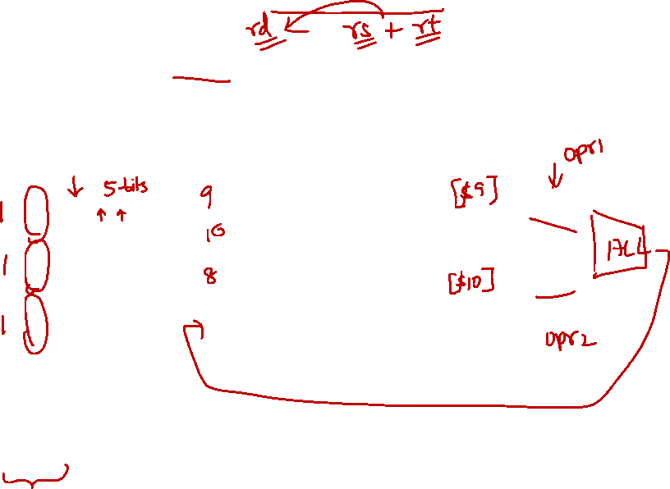
5.2 Decode Stage: R-Format Instruction
add $8, $9, $10
Notation:
Inst [Y:X]
= bits X to Y in Instruction
Inst [25:21]
5
Read
register 1
Read
data 1
32
content of register $9
Inst [20:16]
5
Read
register 2
Register
File
opcode
31:26
rs
25:21
rt
20:16
rd
15:11
shamt
10:6
funct
5:0
5
Write
register
000000
01001
01010
01000
00000
100000
32
content of register $10
Inst [15:11]
Read
data 2
32
Write
data
RegWrite
Result to be stored into register $8 (produced by later stage)

Slide 24
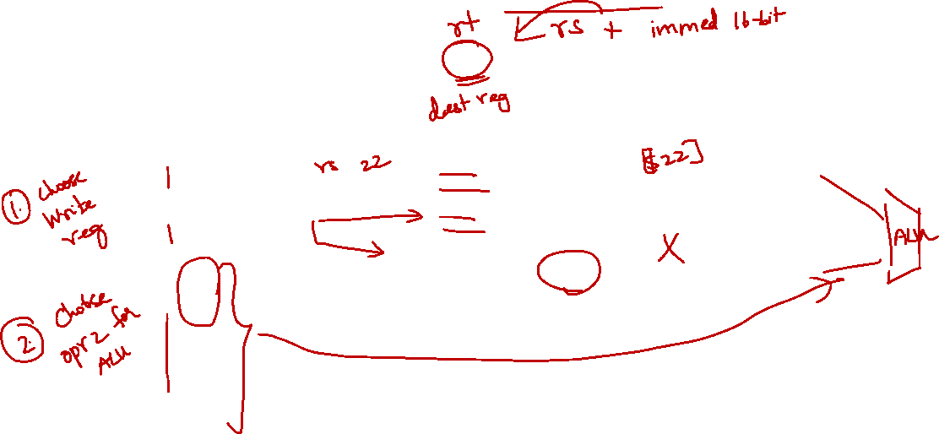
5.2 Decode Stage: I-Format Instruction
addi $21, $22, -50
opcode
31:26
rs
25:21
rt
20:16
Inst [25:21]
5
Read
register 1
Read
data 1
32
content of register $22
Inst [20:16]
5
Read
register 2
Register
File
001000
10110
10101
1111 1111 1100 1110
5
Write
register
Inst [15:11]
Read
data 2
32
Write
data
Immediate
15:0
RegWrite
Problems:
Destination $21 is in the "wrong position"
Read Data 2 is an immediate value, not from register

Slide 25
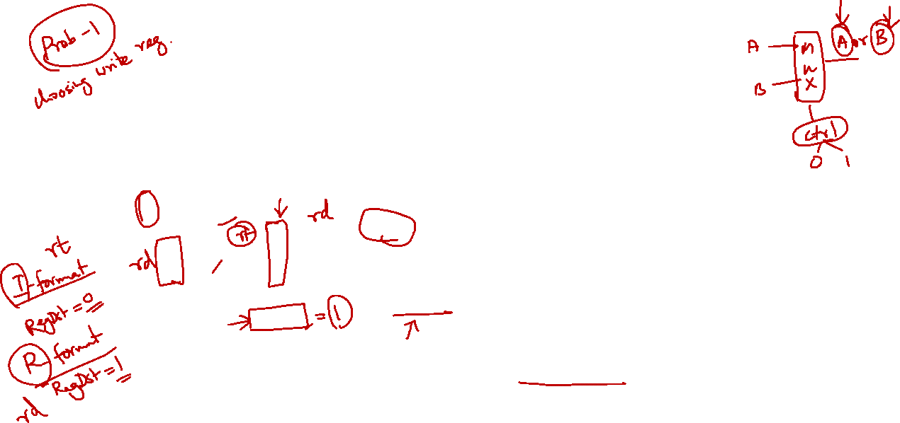
5.2 Decode Stage: Choice in Destination
addi $21, $22, -50
opcode
31:26
rs
25:21
rt
20:16
Inst [25:21]
5
Read
register 1
Read
data 1
32
content of register $22
Inst [20:16]
5
Read
register 2
Register
File
001000
10110
10101
MUX
5
Write
register
1111 1111 1100 1110
Read
data 2
32
Write
data
Inst [15:11]
Immediate
15:0
RegWrite
RegDst
Solution (Write Reg. No.):
Use a multiplexer to choose the correct write register number based on instruction type
RegDst:
A control signal to choose either Inst[20:16] or Inst[15:11] as the write register number

Slide 26
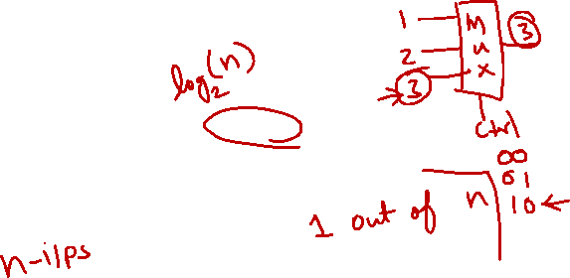
5.2 Multiplexer
Function:
Selects one input from multiple input lines
Inputs:
n lines of same width
Control:
m bits where n = 2^{m}
Output:
Select i^{th} input line if control = i
control
m
MUX
in₀
.
.
.
out
in_{n-1}
Control=0 → select in₀ to out
Control=3 → select in₃ to out
As a Function
// 2 input + 1 control + 1 output
function Mux(in0, in1, ctrl) {
if(!ctrl) {
return in0;
} else {
return in1;
}
}
Can be Combined to Form Larger MUX
function Mux2(in0,in1,in2,in3,ctrl0,ctrl1) {
return Mux(Mux(in0,in1,ctrl0),
Mux(in2,in3,crtl0),
ctrl1);
}

Slide 27
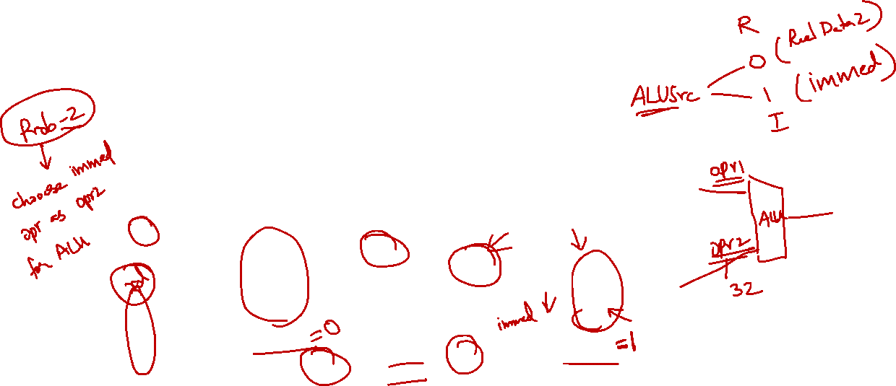
5.2 Decode Stage: Choice in Data 2
addi $21, $22, -50
opcode
31:26
rs
25:21
rt
20:16
Inst [25:21]
5
Read
register 1
Read
data 1
32
content of register $22
Inst [20:16]
5
Read
register 2
Register
File
001000
10110
10101
MUX
5
Write
register
1111 1111 1100 1110
Read
data 2
32
MUX
Write
data
Inst [15:11]
Immediate
15:0
RegWrite
RegDst
ALUSrc
Inst [15:0]
16
Sign Extend
32
ALUSrc:
A control signal to choose either "Read data 2" or the sign extended Inst[15:0] as the second operand
Solution (Rd. Data 2):
Use a multiplexer to choose the correct operand 2.
Sign extend the 16-bit immediate value to 32-bit

Slide 28
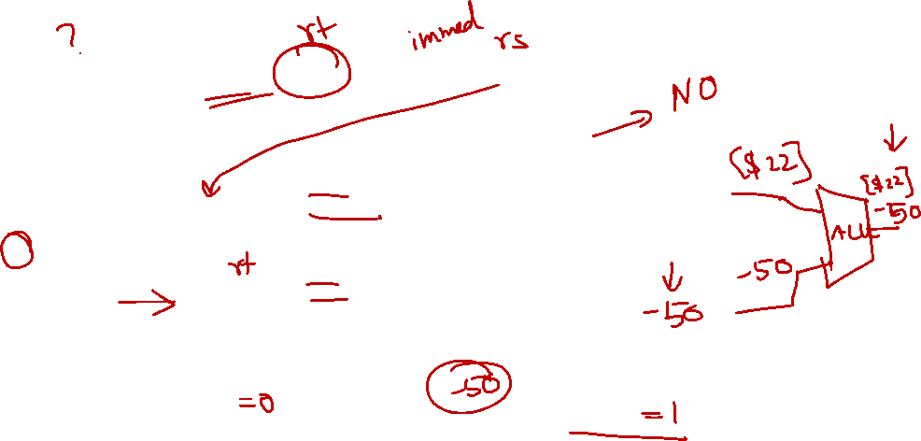
5.2 Decode Stage: Load Word Instruction
lw $21, -50($22)
Do we need any modification?
opcode
31:26
rs
25:21
rt
20:16
Inst [25:21]
5
Read
register 1
Read
data 1
32
content of register $22
Inst [20:16]
5
Read
register 2
Register
File
100011
10110
10101
MUX
5
Write
register
1111 1111 1100 1110
Read
data 2
32
MUX
Write
data
Inst [15:11]
Immediate
15:0
RegWrite
RegDst
ALUSrc
Inst [15:0]
16
Sign Extend
32

Slide 29

5.2 Decode Stage: Branch Instruction
beq $9, $0, 3
opcode
31:26
rs
25:21
rt
20:16
Inst [25:21]
5
Read
register 1
Read
data 1
32
content of register $9
Inst [20:16]
5
Read
register 2
Register
File
000100
01001
00000
MUX
5
Write
register
0000 0000 0000 0011
Read
data 2
32
MUX
Write
data
Inst [15:11]
Immediate
15:0
RegWrite
RegDst
ALUSrc
Inst [15:0]
16
Sign Extend
32
Need to calculate branch outcome and target at the same time!
We will tackle this problem at the ALU stage

Slide 30
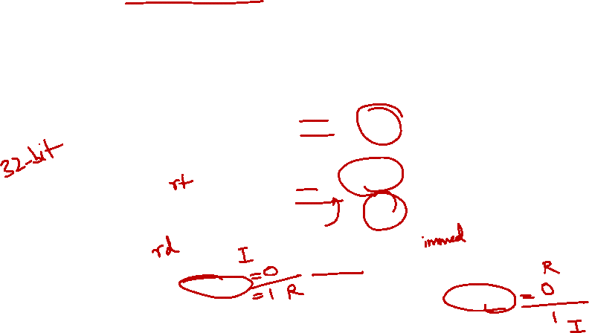
5.2 Decode Stage: Summary
Inst [25:21]
5
Read
register 1
Read
data 1
32
Operand 1
Inst [20:16]
5
Read
register 2
5
Write
register
Register
File
Inst[31:0]
MUX
Read
data 2
32
MUX
Write
data
Operand 2
Inst [15:11]
RegWrite
RegDst
Sign Extend
ALUSrc
Inst [15:0]
16
32

Slide 31
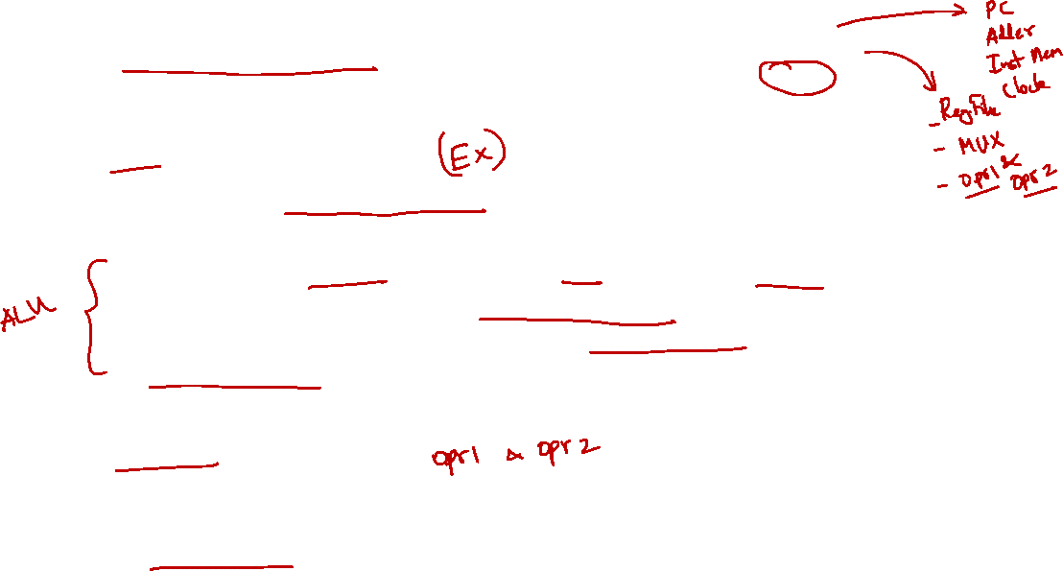
Fetch
Decode
ALU
Memory
RegWrite
5.3 ALU Stage: Requirements
Instruction ALU Stage:
ALU = Arithmetic-Logic Unit
Also called the Execution stage
Perform the real work for most instructions here
Arithmetic (e.g. add, sub), Shifting (e.g. sll), Logical (e.g. and, or)
Memory operation (e.g. lw, sw): Address calculation
Branch operation (e.g. bne, beq): Perform register comparison and target address calculation
Input from previous stage (Decode):
Operation and Operand(s)
Output to the next stage (Memory):
Calculation result

Slide 32
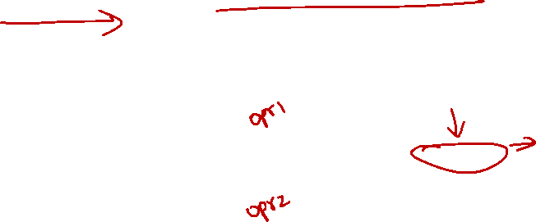
5.3 ALU Stage: Block Diagram
Operands
Memory Stage
Decode Stage
5
Read
register 1
Read
data 1
32
5
Read
register 2
ALU result
Register
File
ALU
5
Write
register
Read
data 2
32
Write
data
RegWrite
Logic to perform arithmetic and logical operations
ALU as a Function (see next slide for cases)
function ALU(A,B,ALUcontrol) {
case 0000:
return [A&B, A&B==0];
case 0001:
return [A|B, A|B==0];
:
}

Slide 33
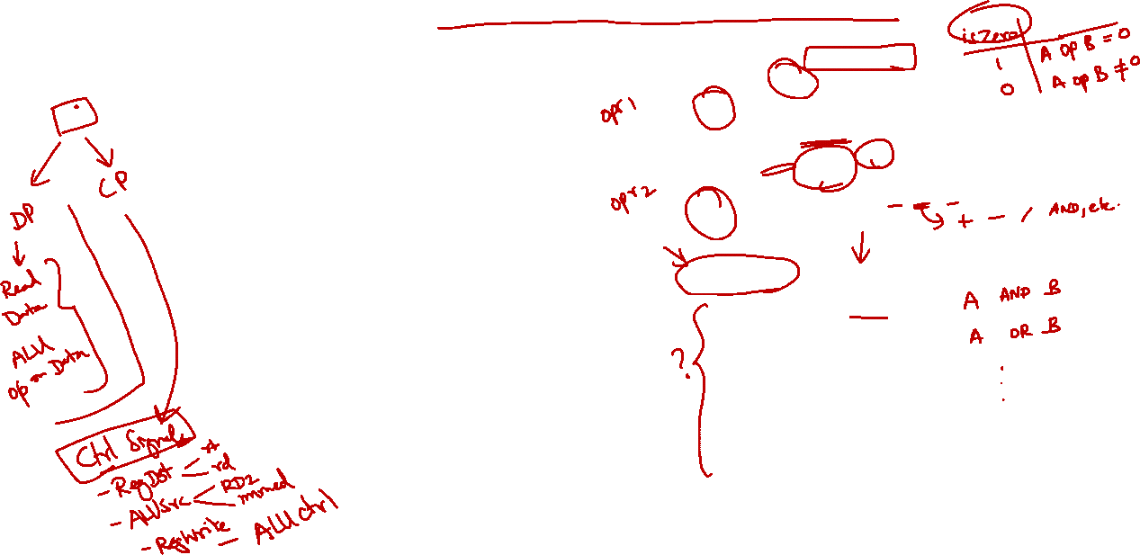
5.3 Element: Arithmetic Logic Unit
ALU (Arithmetic Logic Unit)
Combinational logic to implement arithmetic and logical operations
Inputs:
Two 32-bit numbers
Control:
4-bit to decide the particular operation
Outputs:
Result of arithmetic/logical operation
A 1-bit signal to indicate whether result is zero
ALUcontrol
A
4
32
(A op B) == 0?
isZero?
ALU
ALU
result
32
B
A op B
32
ALUcontrol | Function
0000 | AND
0001 | OR
0010 | add
0110 | subtract
0111 | slt
1100 | NOR

Slide 34
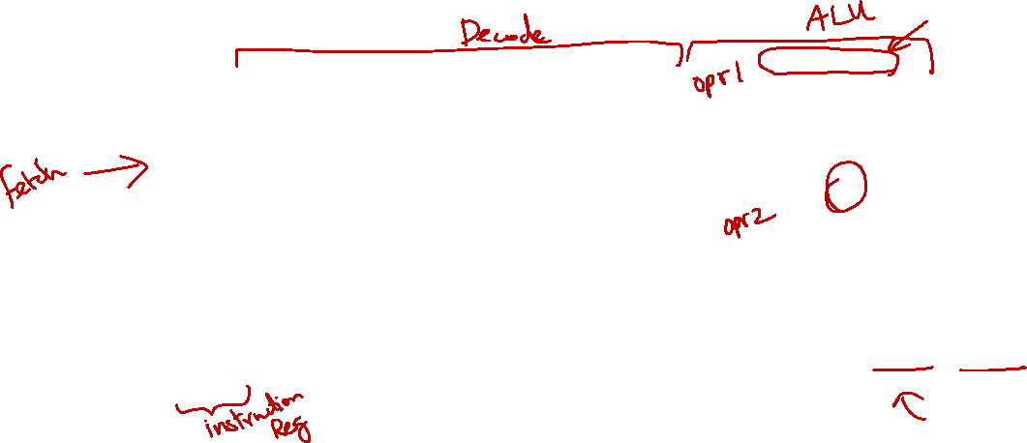
5.3 ALU Stage: Non-Branch Instructions
We can handle non-branch instructions easily:
add $8, $9, $10
ALUcontrol
Inst [25:21]
5
Read
register 1
Read
data 1
32
4
Inst [20:16]
5
Read
register 2
isZero?
Register
File
ALU
opcode
31:26
rs
25:21
rt
20:16
rd
15:11
shamt
10:6
funct
5:0
5
Write
register
ALU
result
32
000000
01001
01010
01000
00000
MUX
100000
Read
data 2
32
MUX
Write
data
Inst [15:11]
RegWrite
RegDst
Sign Extend
ALUSrc
ALUcontrol:
Set using opcode + funct field (more in next lecture)
Inst [15:0]
16
32

Slide 35
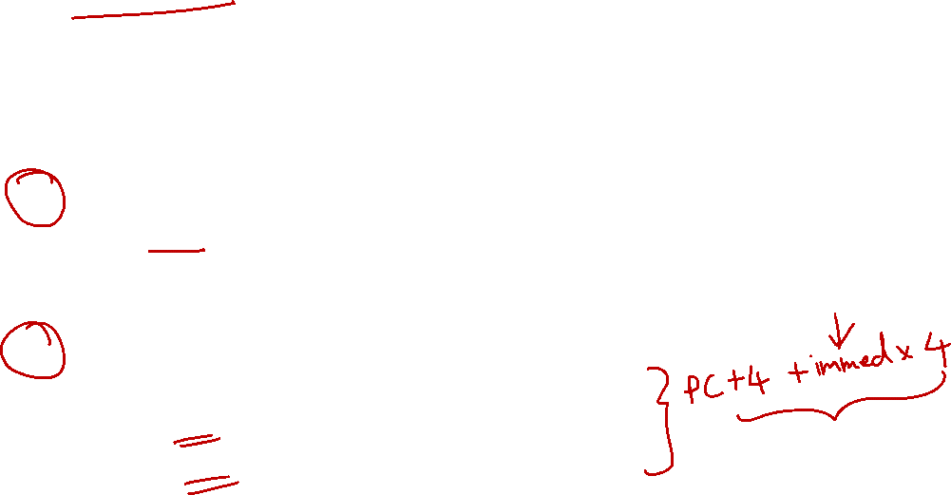
5.3 ALU Stage: Branch Instructions
Branch instruction is harder as we need to perform two calculations:
Example: "beq $9, $0, 3"
Branch Outcome:
Use ALU to compare the register
The 1-bit "isZero?" signal is enough to handle equal/not equal check (how?)
Branch Target Address:
Introduce additional logic to calculate the address
Need PC (from Fetch Stage)
Need Offset (from Decode Stage)
Note
Two things need to happen to actually take the branch.
The instruction is a branch instruction.
The condition of the branch is true.

Slide 36
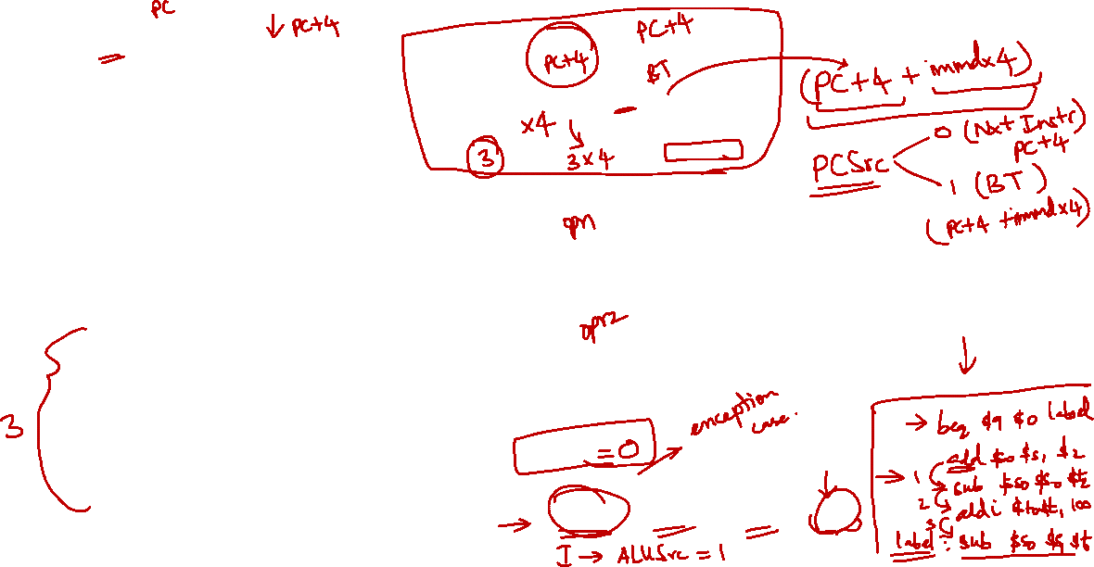
Complete ALU Stage
PC
Add
MUX
4
Add
PCSrc:
Control Signal to select between (PC+4) or Branch Target
Left Shift 2-bit
PCSrc
ALUcontrol
opcode
31:26
rs
25:21
rt
20:16
Inst [25:21]
5
Read
register 1
Read
data 1
32
4
Inst [20:16]
5
Read
register 2
Register
File
isZero?
5
Write
register
ALU
ALU
result
32
000100
01001
00000
0000 0000 0000 0011
MUX
Read
data 2
32
MUX
Write
data
Inst [15:11]
Immediate
15:0
RegWrite
RegDst
Sign Extend
32
ALUSrc
Inst [15:0]
16
beq $9, $0, 3

Slide 37
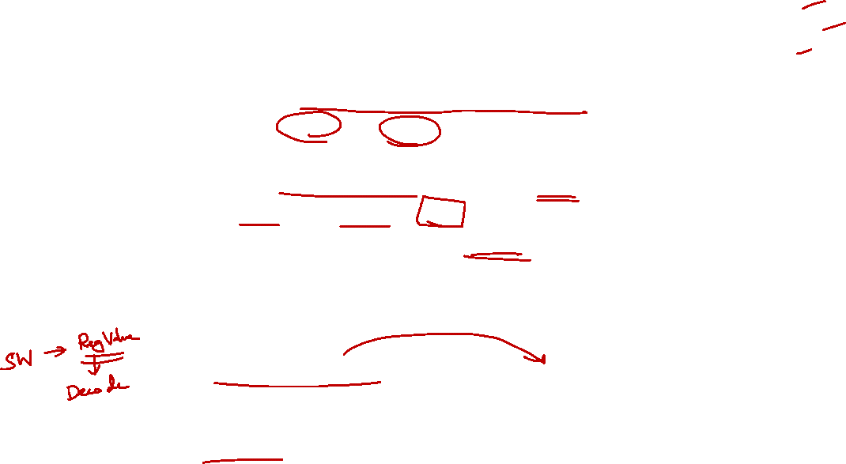
Fetch
Decode
ALU
Memory
RegWrite
5.4 Memory Stage: Requirements
Instruction Memory Access Stage:
Only the load and store instructions need to perform operation in this stage:
Use memory address calculated by ALU Stage
Read from or write to data memory
All other instructions remain idle
Result from ALU Stage will pass through to be used in Register Write stage (see section 5.5) if applicable
Input from previous stage (ALU):
Computation result to be used as memory address (if applicable)
Output to the next stage (Register Write):
Result to be stored (if applicable)

Slide 38
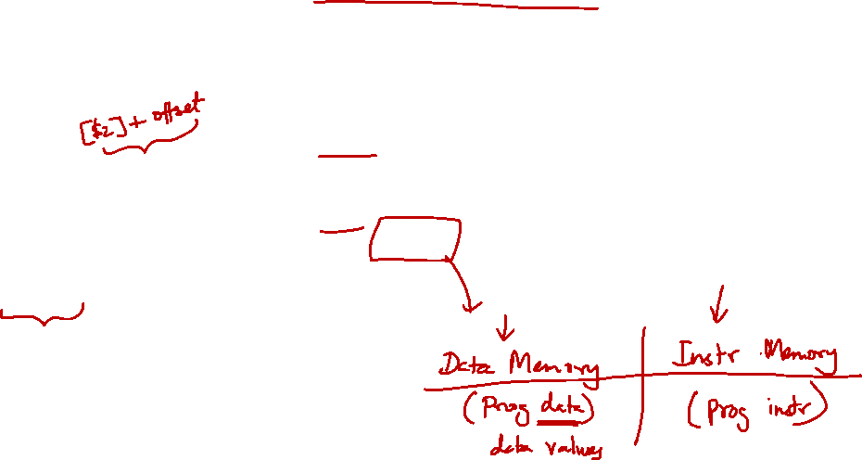
5.4 Memory Stage: Block Diagram
MemWrite
ALU Stage
Register Write Stage
32
Address
Result
Read
Data
32
32
Write
Data
Data
Memory
MemRead
Memory which stores data values

Slide 39
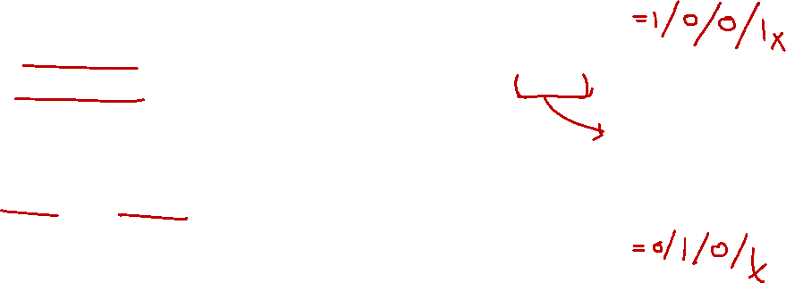
5.4 Element: Data Memory
Storage element for the data of a program
Inputs:
Memory Address
Data to be written (Write Data) for store instructions
Control:
Read and Write controls; only one can be asserted at any point of time
Output:
Data read from memory (Read Data) for load instructions
MemWrite
32
Address
Read
Data
32
32
Write
Data
Data
Memory
MemRead
As a Function
function DataMem(addr,WD,MW,MR) {
if(MW) {
Mem[addr] = WD;
} else if(MR) {
return Mem[addr];
}
}

Slide 40
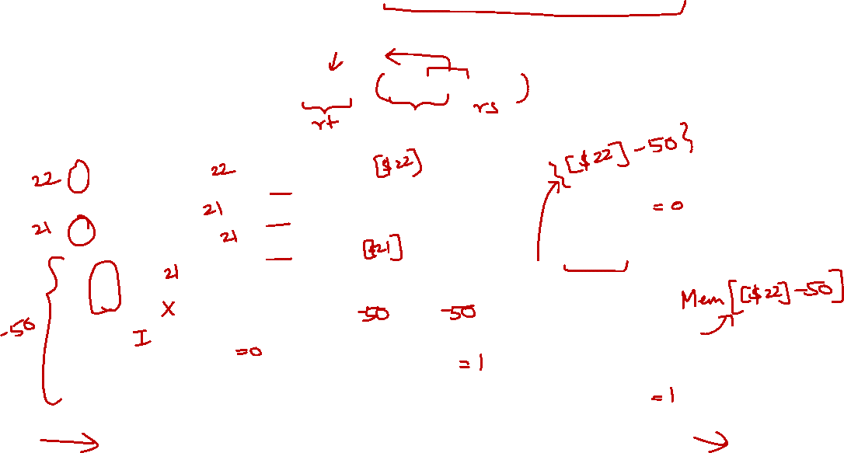
5.4 Memory Stage: Load Instruction
Only relevant parts of Decode and ALU Stages are shown
lw $21, -50($22)
ALUcontrol
opcode
31:26
rs
25:21
rt
20:16
Inst [25:21]
5
4
RR1
RD1
32
Inst [20:16]
5
MemWrite
RR2
Register
File
ALU
100011
10110
10101
5
WR
1111 1111 1100 1110
32
000100
01001
00000
0000 0000 0000 0011
ALU
result
MUX
32
Address
RD2
MUX
WD
Data
Memory
Inst [15:11]
Immediate
15:0
RegWrite
Read
Data
32
RegDst
Write
Data
Sign Extend
ALUSrc
Inst [15:0]
16
32
MemRead

Slide 41
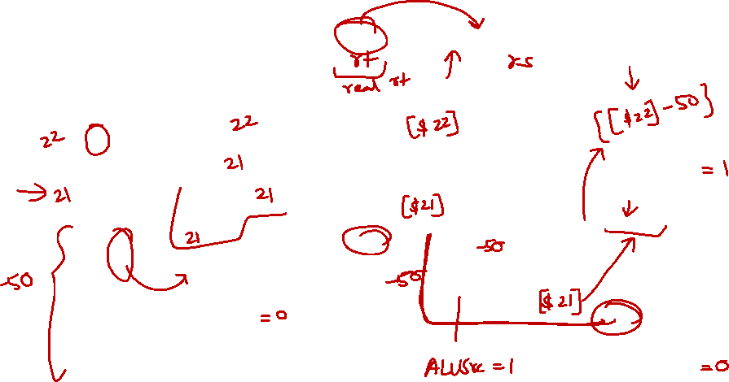
5.4 Memory Stage: Store Instruction
Need Read Data 2 (from Decode stage) as the Write Data
sw $21, -50($22)
ALUcontrol
opcode
31:26
rs
25:21
rt
20:16
Inst [25:21]
5
4
RR1
RD1
32
Inst [20:16]
5
RR2
MemWrite
Register
File
ALU
101011
10110
10101
5
WR
1111 1111 1100 1110
ALU
result
000100
01001
00000
0000 0000 0000 0011
32
MUX
32
Address
RD2
MUX
WD
Data
Memory
Inst [15:11]
Immediate
15:0
RegWrite
Read
Data
32
RegDst
Write
Data
Inst [15:0]
16
Sign Extend
32
MemRead

Slide 42

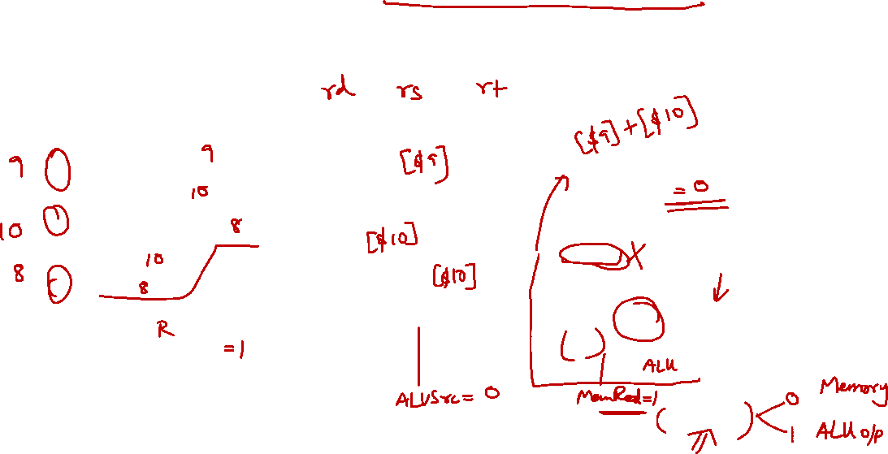
5.4 Memory Stage: Non-Memory Inst.
Add a multiplexer to choose the result to be stored
add $8, $9, $10
ALUcontrol
Inst [25:21]
5
4
RR1
RD1
32
5
MemWrite
Inst [20:16]
RR2
Register
File
ALU
opcode
31:26
rs
25:21
rt
20:16
rd
15:11
shamt
10:6
5
000000
01001
01010
01000
funct
5:0
WR
ALU
result
00000
MUX
100000
32
Address
RD2
MUX
WD
Data
Memory
Inst [15:11]
Read
Data
RegWrite
MUX
RegDst
Write
Data
Inst [15:0]
16
Sign Extend
32
MemToReg:
A control signal to indicate whether result came from memory or ALU unit
MemToReg

Slide 43
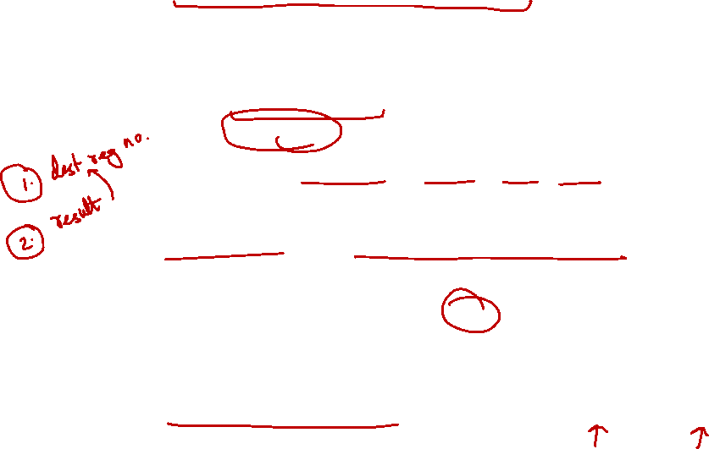
Fetch
Decode
ALU
Memory
RegWrite
5.5 Register Write Stage: Requirements
Instruction Register Write Stage:
Most instructions write the result of some computation into a register
Examples: arithmetic, logical, shifts, loads, set-less-than
Need destination register number and computation result
Exceptions are stores, branches, jumps:
There are no results to be written
These instructions remain idle in this stage
Input from previous stage (Memory):
Computation result either from memory or ALU

Slide 44
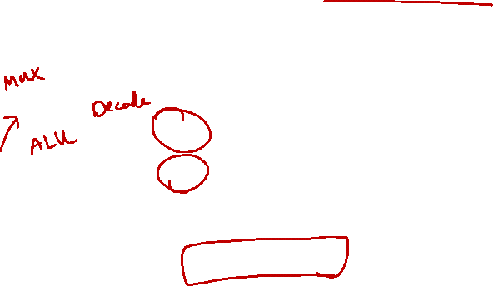
5.5 Register Write Stage: Block Diagram
Memory Stage
5
Read
register 1
Read
data 1
5
Read
register 2
5
Write
register
Register
File
Result
Read
data 2
Write
data
Result Write stage has no additional element:
Basically just route the correct result into register file
The Write Register number is generated way back in the Decode Stage

Slide 45
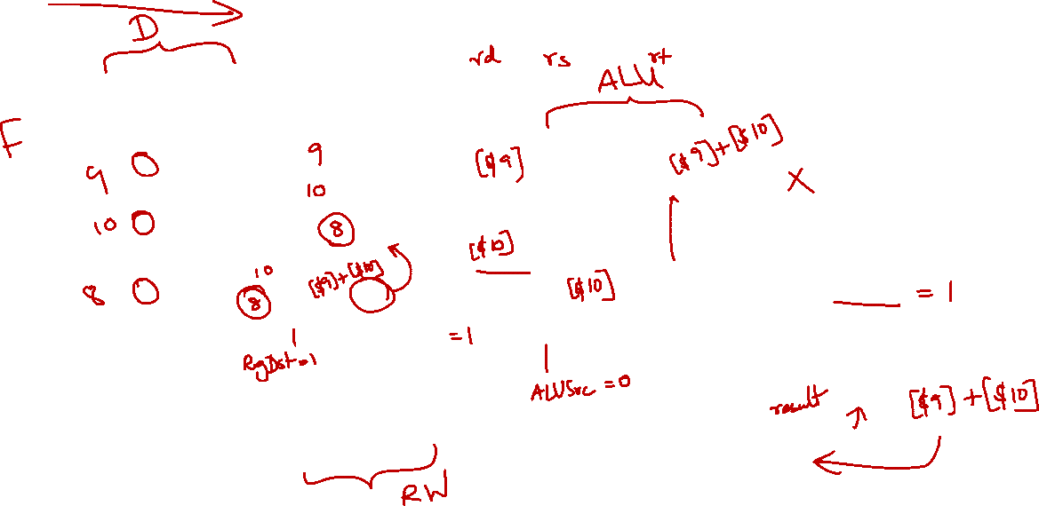
5.5 Register Write Stage: Routing
add $8, $9, $10
ALUcontrol
Inst [25:21]
5
4
RR1
RD1
5
MemWrite
Inst [20:16]
RR2
Register
File
ALU
opcode
31:26
rs
25:21
rt
20:16
rd
15:11
shamt
10:6
5
000000
01001
01010
01000
funct
5:0
WR
ALU
result
00000
MUX
100000
Address
RD2
MUX
WD
Data
Memory
MemToReg
Inst [15:11]
Read
Data
RegWrite
MUX
Write
Data
Inst [15:0]
Sign Extend

Slide 46
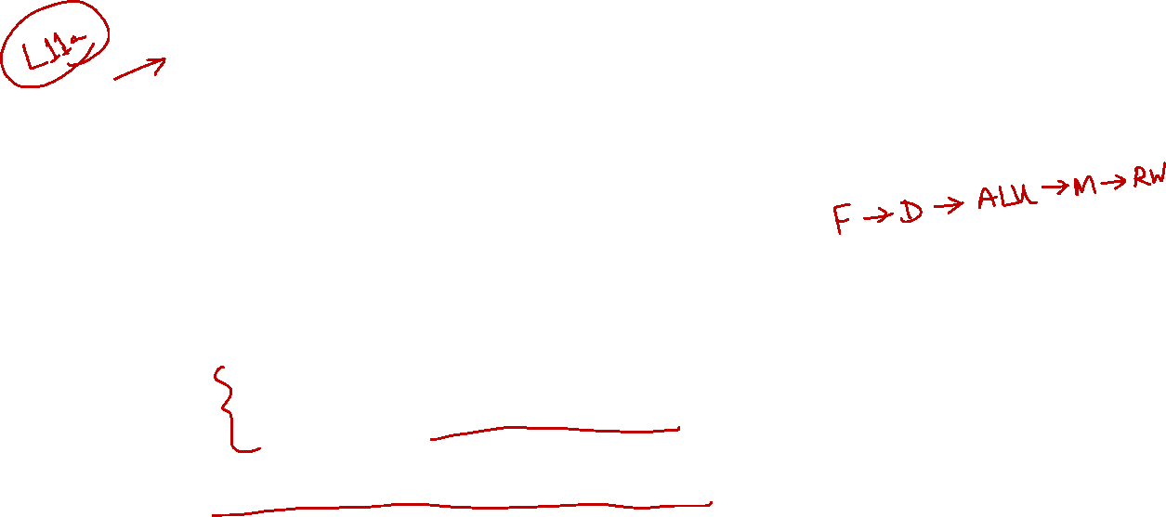
6. The Complete Datapath!
We have just finished “designing” the datapath for a subset of MIPS instructions:
Shifting and Jump are not supported
Check your understanding:
Take the complete datapath and play the role of controller:
See how supported instructions are executed
Figure out the correct control signals for the datapath elements
Coming up next lecture: Control

Slide 47
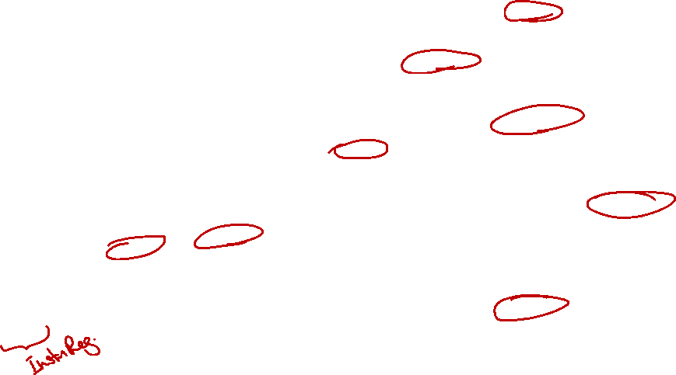
Complete Datapath
Instruction
Memory
PC
Add
MUX
Instruction
4
Left Shift 2-bit
Add
Address
PCSrc
ALUcontrol
Inst [25:21]
5
4
RR1
RD1
Inst [20:16]
5
RR2
is0?
MemWrite
Register
File
ALUSrc
ALU
opcode
31:26
rs
25:21
rt
20:16
rd
15:11
shamt
10:6
5
000000
01001
01010
01000
funct
5:0
WR
ALU
result
00000
MUX
100000
Address
RD2
MUX
WD
Data
Memory
MemToReg
Inst [15:11]
RegWrite
Read
Data
MUX
RegDst
Write
Data
Inst [15:0]
Sign Extend
MemRead

Slide 48

Stages Summaries
Since the components are already described as function, we will also describe the stages as function.
You should look back at the component as a function to understand how we can call them.
This is merely an alternative explanation, you should depend on the original explanation rather than this.

Slide 49
Stages Summaries
function FETCH() {
inst = IM(PC); // read instruction at address from PC
PC = Add(PC,4); // update PC to PC+4
return inst;
}
function DECODE(inst) {
// 1. Read Register
RR1 = inst[21:25]; // $rs
RR2 = inst[16:20]; // $rs
RD1,RD2 = RegRead(RR1, RR2); // read both registers
// 2. Store WR for later use
WR = Mux(inst[16:20], // $rt
inst[11:15], // $rd
RegDst); // control signal
// 3. Choose output
IMM = SignExtend(inst[0:15]); // immediate value
return [RD1, Mux(RD2,IMM,ALUSrc); // choose imm or rd2
}

Slide 50

Stages Summaries
function ALU(A,B,ALUcontrol) {
case 0000: return [A&B , A&B ==0]; // AND
case 0001: return [A|B , A|B ==0]; // OR
case 0010: return [A+B , A+B ==0]; // ADD
case 0110: return [A-B , A-B ==0]; // SUB
case 0111: return [A<B , A<B ==0]; // SLT
case 1100: return [~(A|B), ~(A|B)==0]; // NOR
}
function MEM(alu_res,data) {
mem_res = DataMem(alu_res,data,MemWrite,MemRead);
return Mux(alu_res, mem_res, MemToReg);
}
function WRITEBACK(data) {
RegWrite(data, WR, RegWrite); // WR is global var from DECODE
}

Slide 51

Stages Summaries
function DATAPATH() { // one cycle
// Variables:
inst,RR1,RR2,RD1,RD2,WR,IMM,A,B,alu_res,mem_res,data;
// Controls are assumed to already set correctly
inst = FETCH();
A,B = DECODE(inst);
alu_res = ALU(A,B,ALUControl);
data = MEM(alu_res,RD2,MemWrite,MemRead);
WRITEBACK(data,WR,RegWrite);
}
// Then we can do this in a loop
while(true) {
DATAPATH(); // This is your processor
}

Slide 52
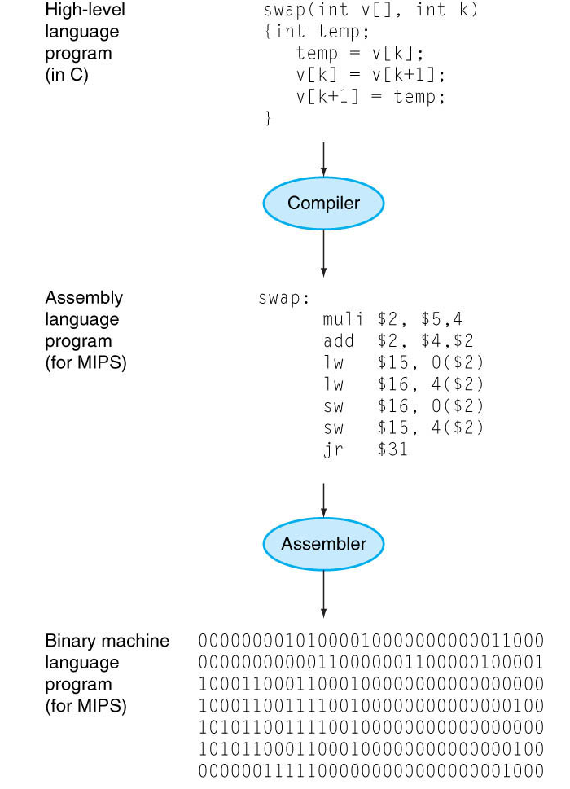
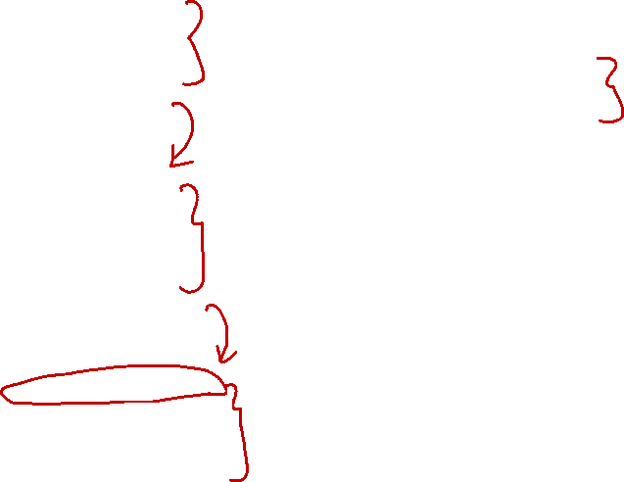
7. Brief Recap (1/4)
Lecture #7, Slide 4
Write program in high-level language (e.g., C)
if(x != 0) { a[0] = a[1] + x;
}

Slide 53

7. Brief Recap (2/4)
Lecture #7, Slide 4
Compiler translates to assembly language (e.g., MIPS)
beq $16, $0, Else
lw $8, 4($17) add $8, $8, $16
sw $8, 0($17)
Else:

Slide 54

7. Brief Recap (3/4)
Lecture #7, Slide 4
Assembler translates to machine code (i.e., binaries)
0001 0010 0000 0000
0000 0000 0000 0011
1000 1110 0010 1000
0000 0000 0000 0100
0000 0010 0000 1000
0100 0000 0001 0100
1010 1110 0010 1000
0000 0000 0000 0000

Slide 55
7. Brief Recap (4/4)
Lecture #7, Slide 4
Processor executes the machine code (i.e., binaries)
PC
4
Instruction
Memory
PCSrc
5
ALUcontrol
5
ALUSrc
MemWrite
5
Register
File
ALU
Data
Memory
MemToReg
RegDst
RegWrite
MemRead

Slide 56

8. From C to Execution
We play the role of Programmer, Compiler, Assembler, and Processor
Program:
if(x != 0) { a[0] = a[1] + x; }
Programmer:
Show the workflow of compiling, assembling and executing C program
Compiler:
Show how the program is compiled into MIPS
Assembler:
Show how the MIPS is translated into binaries
Processor:
Show how the datapath is activated in the processor

Slide 57
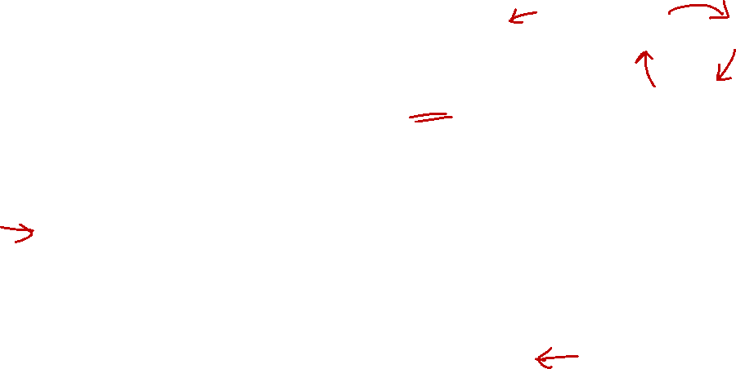
8.1 Writing C Program
Edit, Compile, Execute: Lecture #2, Slide 5
Source code
Compile
Execute
Edit
Edit
produces
recap.c
if(x != 0) { a[0] = a[1] + x;
}
eg: vim recap.c
Executable code
Compile
produces
Cannot compile?
a.out
eg: gcc recap.c
Incorrect result?
Program output
Execute
produces
eg: a.out
No output expected

Slide 58
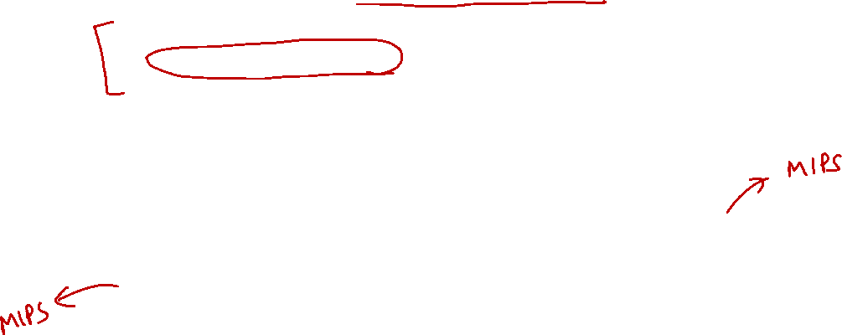
recap.c
if(x != 0) { a[0] =
a[1] + x;
}
8.2 Compiling to MIPS (1/7)
Key Idea #1: Compilation is a structured process
if(x != 0) { a[0] = a[1] + x; }
Each structure can be compiled independently
Inner Structure
Outer Structure
a[0] = a[1] + x;
if(x != 0) {
}

Slide 59

recap.c
if(x != 0) { a[0] =
a[1] + x;
}
8.2 Compiling to MIPS (2/7)
Key Idea #2: Variable-to-Register Mapping
if(x != 0) { a[0] = a[1] + x; }
Let the mapping be:
Variable | Register Name | Register Number
x | $s0 | $16
a | $s1 | $17

Slide 60
Mapping:
x: $16
a: $17
recap.c
if(x != 0) { a[0] =
a[1] + x;
}
8.2 Compiling to MIPS (3/7)
Common Technique #1: Invert the condition for shorter code (Lecture #8, Slide 22)
Outer Structure
Outer MIPS Code
if(x != 0) {
}
beq $16, $0, Else
# Inner Structure
Else:

Slide 61

Mapping:
x: $16
a: $17
$t1: $8
recap.c
if(x != 0) { a[0] =
a[1] + x;
}
8.2 Compiling to MIPS (4/7)
Common Technique #2: Break complex operations, use temp register (Lecture #7, Slide 29)
Inner Structure
Simplified Inner Structure
a[0] = a[1] + x;
$t1 = a[1];
$t1 = $t1 + x;
a[0] = $t1;

Slide 62
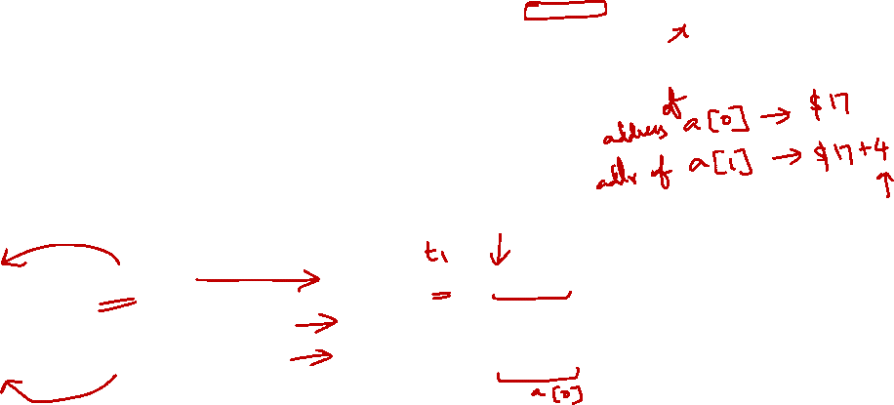
Mapping:
x: $16
a: $17
$t1: $8
recap.c
if(x != 0) { a[0] =
a[1] + x;
}
8.2 Compiling to MIPS (5/7)
Common Technique #3: Array access is lw, array update is sw (Lecture #8, Slide 13)
Simplified Inner Structure
Inner MIPS Code
$t1 = a[1];
$t1 = $t1 + x;
a[0] = $t1;
lw $8, 4($17) add $8, $8, $16
sw $8, 0($17)

Slide 63

Mapping:
x: $16
a: $17
$t1: $8
recap.c
if(x != 0) { a[0]=a[1]+x;
}
8.2 Compiling to MIPS (6/7)
Common Error: Assume that the address of the next word can be found by incrementing the address in a register by 1 instead of by the word size in bytes
Example:
$t1 = a[1]; is translated to lw $8, 4($17) instead of lw $8, 1($17)

Slide 64

Mapping:
x: $16
a: $17
$t1: $8
recap.c
if(x != 0) { a[0]=a[1]+x;
}
8.2 Compiling to MIPS (7/7)
Last Step: Combine the two structures logically
Inner MIPS Code
Outer MIPS Code
lw $8, 4($17) add $8, $8, $16
sw $8, 0($17)
beq $16, $0, Else
# Inner Structure
Else:
Combined MIPS Code
beq $16, $0, Else
lw $8, 4($17) add $8, $8, $16
sw $8, 0($17)
Else:

Slide 65
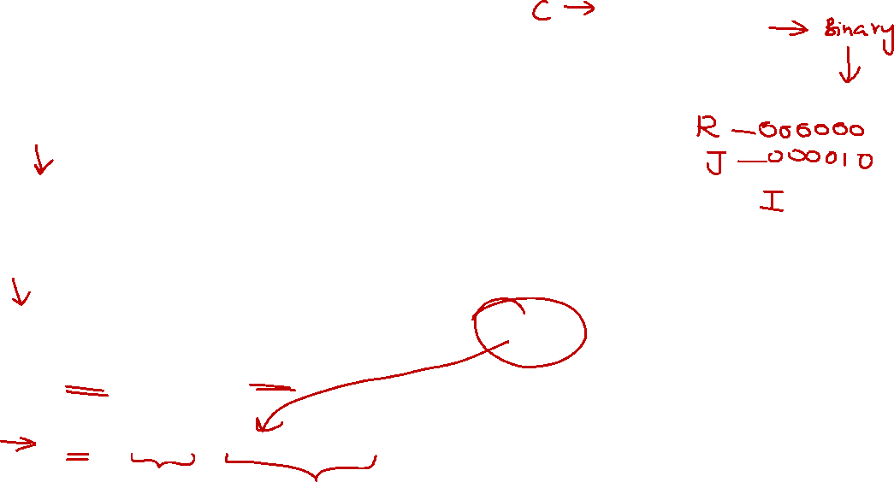
recap.mips
beq $16, $0, Else
lw $8, 4($17) add $8, $8, $16
sw $8, 0($17)
Else:
8.3 Assembling to Binary (1/6)
Instruction Types Used:
R-Format: (Lecture #9, Slide 8)
opcode $rd, $rs, $rt
I-Format: (Lecture #9, Slide 14)
opcode $rt, $rs, immediate
Branch: (Lecture #9, Slide 22)
Uses I-Format
PC = (PC + 4) + (immediate × 4)
6
5
5
5
5
6
opcode
rs
rt
rd
shamt
funct
6
5
5
16
opcode
rs
rt
immediate

Slide 66
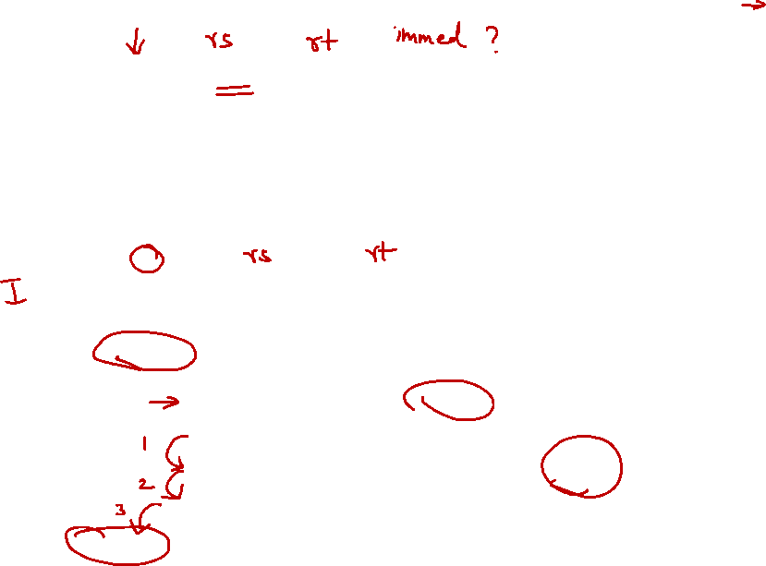
recap.mips
beq $16, $0, Else
lw $8, 4($17) add $8, $8, $16
sw $8, 0($17)
Else:
8.3 Assembling to Binary (2/6)
beq $16, $0, Else
Compute immediate value (Lecture #9, Slide 27)
immediate = 3
Fill in fields (refer to MIPS Reference Data)
Convert to binary
6
5
5
16
4
16
0
3
000100
10000
00000
0000000000000011
beq $16, $0, Else
lw $8, 4($17) add $8, $8, $16
sw $8, 0($17)
Else:
+3

Slide 67
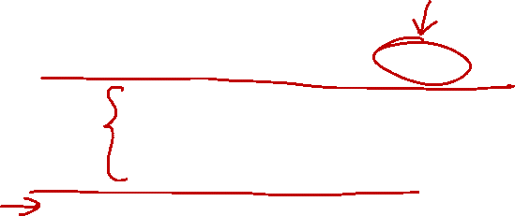
recap.mips
beq $16, $0, Else
lw $8, 4($17) add $8, $8, $16
sw $8, 0($17)
Else:
8.3 Assembling to Binary (2/6)
beq $16, $0, Else
Compute immediate value (Lecture #9, Slide 27)
immediate = 3
Fill in fields (refer to MIPS Reference Data)
Convert to binary
6
5
5
16
4
16
0
3
000100
10000
00000
0000000000000011
beq $16, $0, Else
lw $8, 4($17) add $8, $8, $16
sw $8, 0($17)
Else:

Slide 68
recap.mips
beq $16, $0, Else
lw $8, 4($17) add $8, $8, $16
sw $8, 0($17)
Else:
8.3 Assembling to Binary (2/6)
beq $16, $0, Else
Compute immediate value (Lecture #9, Slide 27)
immediate = 3
Fill in fields (refer to MIPS Reference Data)
Convert to binary
6
5
5
16
4
16
0
3
000100
10000
00000
0000000000000011
beq $16, $0, Else
lw $8, 4($17) add $8, $8, $16
sw $8, 0($17)
Else:

Slide 69
recap.mips
beq $16, $0, Else
lw $8, 4($17) add $8, $8, $16
sw $8, 0($17)
Else:
8.3 Assembling to Binary (2/6)
beq $16, $0, Else
Compute immediate value (Lecture #9, Slide 27)
immediate = 3
Fill in fields (refer to MIPS Reference Data)
Convert to binary
6
5
5
16
4
16
0
3
000100
10000
00000
0000000000000011
beq $16, $0, Else
lw $8, 4($17) add $8, $8, $16
sw $8, 0($17)
Else:

Slide 70
recap.mips
beq $16, $0, Else
lw $8, 4($17) add $8, $8, $16
sw $8, 0($17)
Else:
8.3 Assembling to Binary (2/6)
beq $16, $0, Else
Compute immediate value (Lecture #9, Slide 27)
immediate = 3
Fill in fields (refer to MIPS Reference Data)
Convert to binary
6
5
5
16
4
16
0
3
000100
10000
00000
0000000000000011
beq $16, $0, Else
lw $8, 4($17) add $8, $8, $16
sw $8, 0($17)
Else:
+3

Slide 71

recap.mips
beq $16, $0, Else
lw $8, 4($17) add $8, $8, $16
sw $8, 0($17)
Else:
8.3 Assembling to Binary (3/6)
lw $8, 4($17)
Fill in fields (refer to MIPS Reference Data)
Convert to binary
6
5
5
16
35
17
8
4
100011
10001
01000
0000000000000100
0001 0010 0000 0000 0000 0000 0000 0011
lw $8, 4($17) add $8, $8, $16
sw $8, 0($17)
Else:

Slide 72

recap.mips
beq $16, $0, Else
lw $8, 4($17) add $8, $8, $16
sw $8, 0($17)
Else:
8.3 Assembling to Binary (4/6)
add $8, $8, $16
Fill in fields (refer to MIPS Reference Data)
Convert to binary
6
5
5
5
5
6
0
8
16
8
0
32
000000
01000
10000
01000
00000
100000
0001 0010 0000 0000 0000 0000 0000 0011
1000 1110 0010 1000 0000 0000 0000 0100 add $8, $8, $16
sw $8, 0($17)
Else:

Slide 73

recap.mips
beq $16, $0, Else
lw $8, 4($17) add $8, $8, $16
sw $8, 0($17)
Else:
8.3 Assembling to Binary (5/6)
sw $8, 0($17)
Fill in fields (refer to MIPS Reference Data)
Convert to binary
6
5
5
16
43
17
8
0
101011
10001
01000
0000000000000000
0001 0010 0000 0000 0000 0000 0000 0011
1000 1110 0010 1000 0000 0000 0000 0100 0000 0001 0001 0000 0100 0000 0010 0000
sw $8, 0($17)
Else:

Slide 74

recap.mips
beq $16, $0, Else
lw $8, 4($17) add $8, $8, $16
sw $8, 0($17)
Else:
8.3 Assembling to Binary (6/6)
Final Binary
Hard to read?
Don’t worry, this is intended for machine not for human!
0001 0010 0000 0000 0000 0000 0000 0011
1000 1110 0010 1000 0000 0000 0000 0100 0000 0001 0001 0000 0100 0000 0010 0000
1010 1110 0010 1000 0000 0000 0000 0000

Slide 75

recap.mips
beq $16, $0, Else
lw $8, 4($17) add $8, $8, $16
sw $8, 0($17)
Else:
8.4 Execution (Datapath)
Given the binary
Assume two possible executions:
$16 == $0 (shorter)
$16 != $0 (longer )
Convention:
Fetch: Memory:
Decode: Reg Write:
ALU: Other:
0001 0010 0000 0000 0000 0000 0000 0011
1000 1110 0010 1000 0000 0000 0000 0100 0000 0001 0001 0000 0100 0000 0010 0000
1010 1110 0010 1000 0000 0000 0000 0000

Slide 76

beq $16, $0, Else
Assume $16 == $0
Instruction
Memory
PC
Add
MUX
Instruction
4
Left Shift 2-bit
Add
Address
PCSrc
opcode
31:26
000100
ALUcontrol
rs
25:21
10000
Inst [25:21]
5
$16
4
RR1
RD1
5
$0
R[$16]
TRUE
Inst [20:16]
RR2
is0?
MemWrite
rt
20:16
00000
Register
File
ALU
5
WR
ALUSrc
MUX
ALU
result
Address
RD2
MUX
WD
R[$0]
Data
Memory
MemToReg
Inst [15:11]
immediate
10:6
RegWrite
Read
Data
MUX
0000000000000011
RegDst
Write
Data
Inst [15:0]
Sign Extend
MemRead

Slide 77

beq $16, $0, Else
Assume $16 != $0
Instruction
Memory
PC
Add
MUX
Instruction
4
Left Shift 2-bit
Add
Address
PCSrc
opcode
31:26
000100
ALUcontrol
rs
25:21
10000
Inst [25:21]
5
$16
4
RR1
RD1
5
$0
R[$16]
is0?
FALSE
MemWrite
rt
20:16
Inst [20:16]
RR2
00000
Register
File
ALUSrc
ALU
MUX
5
WR
ALU
result
MUX
Address
RD2
R[$0]
WD
Data
Memory
MemToReg
Inst [15:11]
immediate
10:6
RegWrite
Read
Data
MUX
0000000000000011
RegDst
Write
Data
Inst [15:0]
Sign Extend
MemRead

Slide 78

lw $8, 4($17)
Assume $16 != $0
Instruction
Memory
PC
Add
MUX
Instruction
4
Left Shift 2-bit
Add
Address
PCSrc
opcode
31:26
100011
ALUcontrol
rs
25:21
10001
Inst [25:21]
5
$17
4
RR1
RD1
5
R[$17]
is0?
MemWrite
rt
20:16
Inst [20:16]
RR2
01000
$8
Register
File
ALUSrc
ALU
MUX
5
WR
ALU
result
R[$17]+4
MUX
Address
M[R[$17]+4]
RD2
4
WD
Data
Memory
MemToReg
Inst [15:11]
immediate
10:6
RegWrite
Read
Data
MUX
0000000000000100
RegDst
Write
Data
M[R[$17]+4]
Inst [15:0]
Sign Extend
MemRead

Slide 79

add $8, $8, $16
Assume $16 != $0
Instruction
Memory
PC
Add
MUX
Instruction
4
Left Shift 2-bit
Add
Address
PCSrc
ALUcontrol
Inst [25:21]
5
$8
4
RR1
RD1
5
$16
R[$8]
is0?
MemWrite
Inst [20:16]
RR2
$8
Register
File
ALUSrc
ALU
opcode
31:26
rs
25:21
rt
20:16
rd
15:11
shamt
10:6
5
000000
01000
10000
01000
funct
5:0
WR
ALU
result
00000
100000
MUX
Address
R[$8]+R[$16]
RD2
MUX
WD
R[$16]
Data
Memory
MemToReg
Inst [15:11]
RegWrite
Read
Data
MUX
RegDst
Write
Data
Inst [15:0]
Sign Extend
MemRead

Slide 80

sw $8, 0($17)
Assume $16 != $0
Instruction
Memory
PC
Add
MUX
Instruction
4
Left Shift 2-bit
Add
Address
PCSrc
opcode
31:26
101011
Question
Can you fill in the values like in previous slides?
ALUcontrol
rs
25:21
10001
Inst [25:21]
5
4
RR1
RD1
Inst [20:16]
5
RR2
is0?
MemWrite
rt
20:16
01000
Register
File
ALU
5
WR
ALUSrc
MUX
ALU
result
Address
RD2
MUX
WD
Data
Memory
MemToReg
Inst [15:11]
immediate
10:6
RegWrite
Read
Data
MUX
0000000000000000
RegDst
Write
Data
Inst [15:0]
Sign Extend
MemRead

Slide 81
Reading
The Processor: Datapath and Control
COD Chapter 5 Sections 5.1 – 5.3 (3rd edition)
COD Chapter 4 Sections 4.1 – 4.3 (4th edition)

Slide 82
End of File

